Slide 1
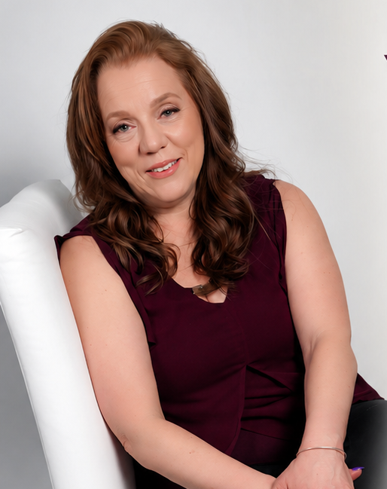

Captivate
Your Audience
With Author & Speaker Sandra Smith

Slide 2
MEET SANDRA
Author, Speaker & Founder
Your New Life Ministries
Sandra Smith is a passionate motivational speaker dedicated to sharing messages that inspire, uplift, and transform lives.
With a heart for authentic connection, Sandra helps aspiring speakers find their voice and captivate any audience.
Inspiring
Authentic
Transformative
Sandra Smith

Slide 3


Where Do I Start?
Taking Your First Steps into Motivational Speaking
01
02
A Message Burning in Your Heart
Have You Already Written Messages?
You must have a desire and a message you are passionate about sharing
Start putting your thoughts on paper and refining your content
03
04
Share at Your Church or Events
Post to Social Media & Blogs
Look for opportunities to speak at local gatherings and events
Get your message out there and build your online presence

Slide 4
YOUR ROADMAP
Build Your Presence Online
Show the world you have a vital message
1
2
3
4
Write & Publish
Go Social
Invite Feedback
Show Up
Write your messages and post them to your blog or website.
Share your content across social media platforms consistently.
Allow comments on posts and invite reviews from your audience.
Maintain a visible, active online presence that demonstrates your expertise.

Slide 5


Perfect Your Message
Present Yourself as a Professional
Ask People You Know
Pay Attention to Comments & Reviews
Get honest feedback from trusted friends and colleagues
Learn from the feedback on your posts and social media
Give a Freebie with Your Business Card
Listen to Other Speakers
At events, offer something valuable and invite reviews afterward
Study how successful speakers present themselves online and on stage

Slide 6
BE AUTHENTIC!
"
You must be yourself. You can listen to others, but you must be yourself.
"
People can spot a fake. Your authenticity is your greatest asset. If your message appears copied, speaking invitations will not follow. Listen, learn, and be inspired by others — but always let YOUR unique voice shine through.

Slide 7
Be Flexible
Adapt Your Message to Every Venue
Adapt to the Event
Read the Room
Tailor your messages to what the event coordinator wants you to share. Every audience is different — customize your delivery to fit the occasion and the expectations of your host.
VS
If you are a Christian speaker at a non-religious venue, adapt your message without coming across as preachy. Meet people where they are while staying true to your core message.
Customize Your Delivery
Stay Authentic, Stay Relevant
FLEXIBILITY IS YOUR SUPERPOWER

Slide 8
Engage the Audience & Show Humor
Connection is Everything
Use Humor
Tell Personal Stories
Lighten heavy topics with well-placed humor to keep your audience engaged and open to your message.
Share a story about yourself that ties to your message, especially if it adds a humorous or relatable touch.
Get Interactive
Make It Memorable
Ask the audience to raise their hands if they have experienced what you are talking about — instant connection.
Create moments of genuine connection that your audience will remember long after the event ends.

Slide 9

Close with Powerful Takeaways
Leave a Lasting Impression
1
End with clear, memorable points your audience should remember — give them something to take home in their hearts
2
Always share your website at the end so they can continue to be blessed by your messages and resources
3
Set up a table with freebies, business cards, and anything else you are offering — make it inviting and accessible
4
Share your business cards with your email address so people can reach you for future speaking engagements
5
Make it easy for your audience to stay connected with you — the relationship doesn't end when you leave the stage
Your closing is your invitation to a lasting connection

Slide 10

Let's Connect!
SANDRA SMITH — AUTHOR & SPEAKER
EMAIL
WEBSITE
PHONE
info@yournewlifeministries.org
www.yournewlifeministries.org
888-519-0707
Book Sandra for your next event and captivate your audience!

